Slide 1

의료정보학시스템
Device on FHIR 2
Dept. of Computer Science & Engineering
College of IT
Kyungpook National University
2017.10.30.

Slide 2
Resources
DeviceComponent
<MDS>
source
Device
parent
source
DeviceComponent
<VMD>
source
source
parent
DeviceComponent
<CHAN>
parent
DeviceMetric
device
Observation
Patient
subject

Slide 3
Device Resource
This resource identifies an instance or a type of a manufactured item that is used in the provision of healthcare without being substantially changed through that activity.
The device may be a medical or non-medical device.
Medical devices include durable (reusable) medical equipment, implantable devices, as well as disposable equipment used for diagnostic, treatment, and research for healthcare and public health.
Non-medical devices may include items such as a machine, cellphone, computer, application, etc

Slide 4
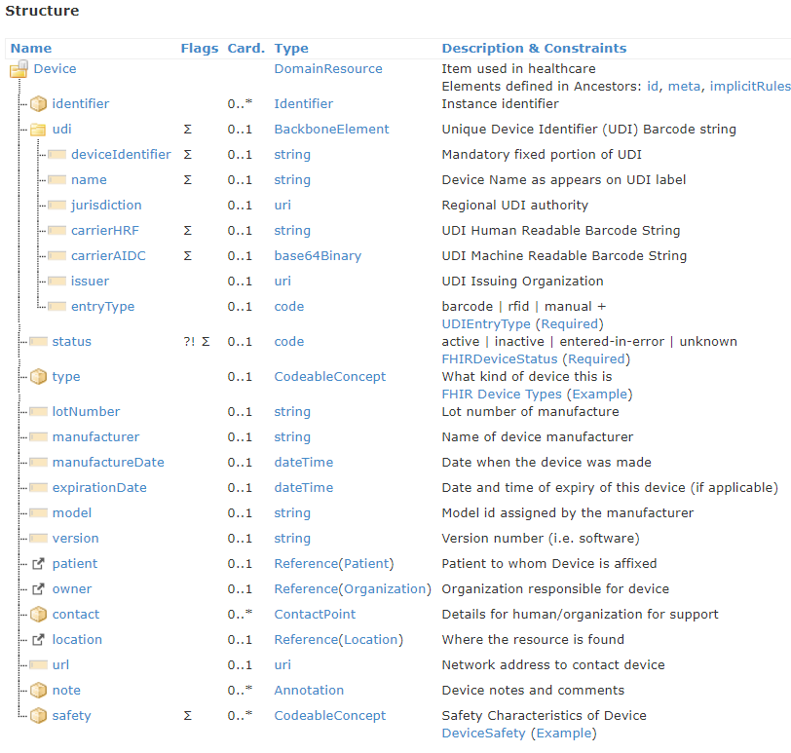
Device Resource

Slide 5
Device Resource
Device
<Device xmlns="http://hl7.org/fhir">
<identifier>
<system value="http://acme.org/devices/serialnumber"/>
<value value="1111"/>
</identifier>
<type>
<coding>
<system value=" urn:iso:std:iso:11073:10101"/>
<code value="528456"/>
<display value="MDC_DEV_SPEC_PROFILE_AI_MED_MINDER"/>
</coding> </type>
<status value="available"/>
<manufacturer value="Healthall, Inc"/> 회사명
<model value="Cabinet0009"/> device일련번호/이름
<udi value="00:EA:21:02:03:56"/> 블루투스 주소
<location>
<reference value="Location/10811"/> Location
</location>
<patient>
<reference value="Patient/10810"/> Patient
</patient>
<contact>
<value value="0123456789"/>
<use value="mobile"/>
</contact>
</Device>
http://wiki.hl7.org/index.php?title=DoF_2017-JAN_IHE_NA_CAT_Cleveland
http://hl7.org/fhir/device.html

Slide 6
DeviceComponent Resource
The characteristics, operational status and capabilities of a medical-related component of a medical device.

Slide 7
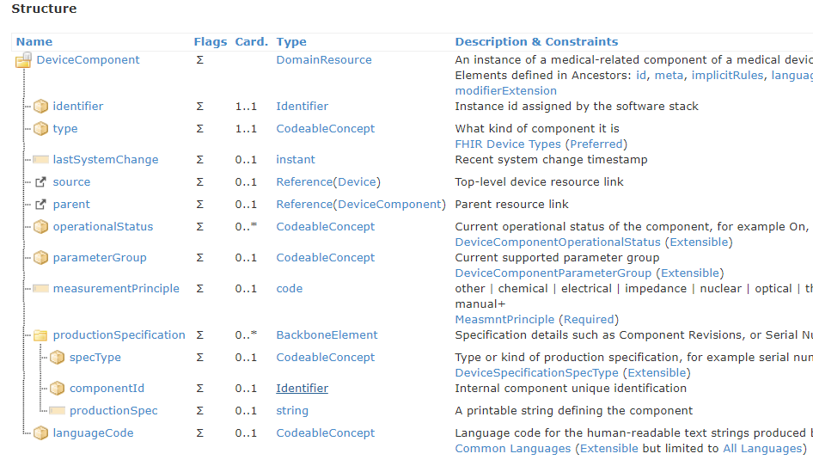
DeviceComponent Resource

Slide 8
DeviceComponent Resource
DeviceComponent
<MDS>
source
Device
parent
source
DeviceComponent
<VMD>
source
source
parent
DeviceComponent
<CHAN>
parent
DeviceMetric
device
Observation
Patient
subject

Slide 9
DeviceComponent Resource
MDS: medical device system – Device system to check
VMD: virtual medical device – An abstract representation of a medical-related subsystem of an MDS
CHAN: - channel: sensor channel

Slide 10
DeviceComponent Resource
DeviceComponent
<DeviceComponent xmlns="http://hl7.org/fhir">
<type>
<coding>
<system value="urn:iso:std:iso:11073:10101"/>
<code value="4173"/>
<display value="MDC_DEV_ANALY_PRESS_BLD_MDS"/>
</coding>
</type>
<identifier>
<system value="http://www.vanilla.co.kr"/>
<value value="mds001"/>
</identifier>
<lastSystemChange value="1985-01-01T00:00:00.000+09:00"/>
<source>
<reference value="urn:uuid:6648f3ff-8a51-470a-863a-7605ee44e0bf"/>
</source>
<operationalStatus>
<coding>
<code value="on"/>
</coding>
</operationalStatus>
</DeviceComponent>

Slide 11
DeviceMetric Resource
Describes a measurement, calculation or setting capability of a medical device.

Slide 12
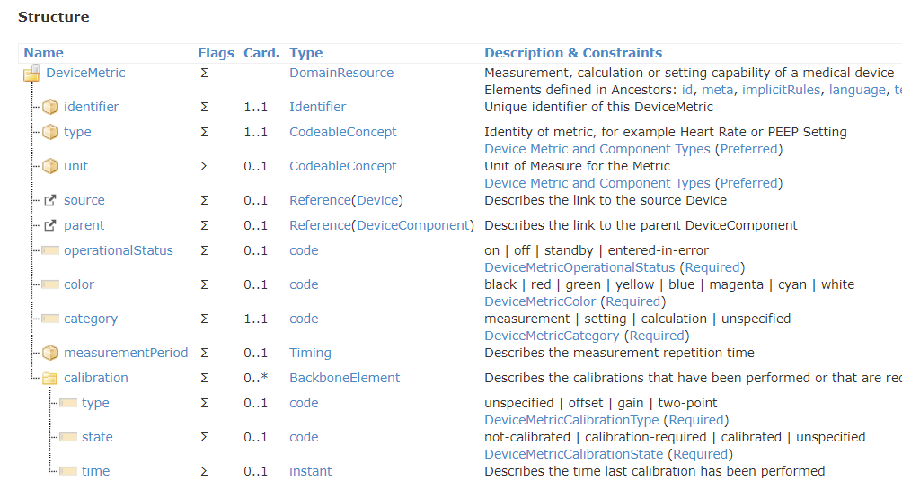
DeviceMetric Resource

Slide 13
DeviceMetric Resource
DeviceMetric
<DeviceMetric xmlns="http://hl7.org/fhir">
<type>
<coding>
<system value="https://rtmms.nist.gov"/>
<code value="150020"/>
<display value="MDC_PRESS_BLD_NONINV"/>
</coding>
</type>
<identifier>
<system value="http://www.vanilla.kr"/>
<value value="metric001"/>
</identifier>
<unit>
<coding>
<system value="https://rtmms.nist.gov"/>
<code value="266016"/>
<display value="MDC_DIM_MMHG"/>
</coding>
</unit>
<source>
<reference value="urn:uuid:6648f3ff-8a51-470a-863a-7605ee44e0bf"/>
</source>
<parent>
<reference value="urn:uuid:bac755fc-5f70-45b0-aae8-15cbf6a4bdf1"/>
</parent>
<operationalStatus value="on"/>
<category value="measurement"/>
</DeviceMetric>

Slide 14
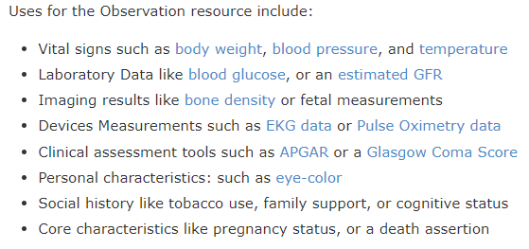
Observation Resource
Measurements and simple assertions made about a patient, device or other subject.

Slide 15
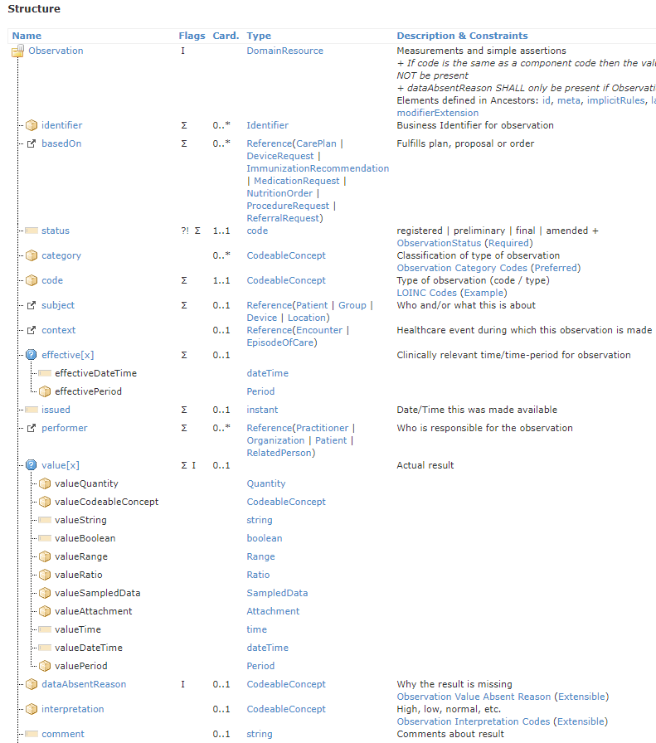
Observation Resource
https://www.hl7.org/fhir/observation.html

Slide 16
Observation Resource
DeviceMetric
<Observation xmlns="http://hl7.org/fhir">
<identifier>
<system value="http://www.knu.ac.kr"/>
<value value="bpm001"/>
</identifier>
<status value="registered"/>
<code>
<coding>
<system value="https://rtmms.nist.gov"/>
<code value="150020"/>
<display value="MDC_PRESS_BLD_NONINV"/>
</coding>
</code>
<subject>
<reference
value="urn:uuid:5f5027b6-3a46-41e5-8d99-a31673b9429b"/>
</subject>
<effectiveDateTime value="1985-01-01"/>
<bodySite>
<coding>
<system value="http://snomed.info/sct"/>
<code value="368209003"/>
</coding>
</bodySite>
<device>
<reference
value="urn:uuid:2dd661d5-80b1-4276-9f7c-3c5afbe831ad"/>
</device>
<component>
<code>
<coding>
<system value="https://rtmms.nist.gov"/>
<code value="150021"/>
<display value="MDC_PRESS_BLD_NONINV_SYS"/>
</coding>
</code>
<valueQuantity>
<value value="120"/>
<unit value="mm[Hg]"/>
</valueQuantity>
</component>
<component>
<code>
<coding>
<system value="https://rtmms.nist.gov"/>
<code value="150022"/>
<display value="MDC_PRESS_BLD_NONINV_DIA"/>
</coding>
</code>
<valueQuantity>
<value value="80"/>
<unit value="mm[Hg]"/>
</valueQuantity>
</component>
<component>
<code>
<coding>
<system value="https://rtmms.nist.gov"/>
<code value="150023"/>
<display value="MDC_PRESS_BLD_NONINV_MEAN"/>
</coding>
</code>
<valueQuantity>
<value value="100"/>
<unit value="mm[Hg]"/>
</valueQuantity>
</component>
</Observation>

Slide 17
Observation Resource
DeviceMetric
<Observation xmlns="http://hl7.org/fhir">
<identifier>
<system value="http://www.knu.ac.kr"/>
<value value="bpm001"/>
</identifier>
<status value="registered"/>
<code>
<coding>
<system value="https://rtmms.nist.gov"/>
<code value="150020"/>
<display value="MDC_PRESS_BLD_NONINV"/>
</coding>
</code>
<subject>
<reference
value="urn:uuid:5f5027b6-3a46-41e5-8d99-a31673b9429b"/>
</subject>
<effectiveDateTime value="1985-01-01"/>
<bodySite>
<coding>
<system value="http://snomed.info/sct"/>
<code value="368209003"/>
</coding>
</bodySite>
<device>
<reference
value="urn:uuid:2dd661d5-80b1-4276-9f7c-3c5afbe831ad"/>
</device>
<component>
<code>
<coding>
<system value="https://rtmms.nist.gov"/>
<code value="150021"/>
<display value="MDC_PRESS_BLD_NONINV_SYS"/>
</coding>
</code>
<valueQuantity>
<value value="120"/>
<unit value="mm[Hg]"/>
</valueQuantity>
</component>
<component>
<code>
<coding>
<system value="https://rtmms.nist.gov"/>
<code value="150022"/>
<display value="MDC_PRESS_BLD_NONINV_DIA"/>
</coding>
</code>
<valueQuantity>
<value value="80"/>
<unit value="mm[Hg]"/>
</valueQuantity>
</component>
<component>
<code>
<coding>
<system value="https://rtmms.nist.gov"/>
<code value="150023"/>
<display value="MDC_PRESS_BLD_NONINV_MEAN"/>
</coding>
</code>
<valueQuantity>
<value value="100"/>
<unit value="mm[Hg]"/>
</valueQuantity>
</component>
</Observation>

Slide 18
Assignment
Make Device, DeviceComponent, DeviceMetric, Observation resource using Hapi FHIR library.
Summit source code and result screen.

Slide 19


